Slide 1
Reducing Anxiety through Reiki & Massage

Slide 2
40,000,000
Forty Million people over the age of 18 in the US are affected with an ANXIETY DISORDER each year! It is the most common mental health condition in the United States.

Slide 3
How much do you know about Anxiety?
Raise your hand if you think a statement is TRUE
Anxiety is the number one form of mental illness in the United States.
Approximately 10% of teenagers and 40% of adults suffer from an anxiety disorder of some kind.
Anxiety disorders are often accompanied by other disorders like DEPRESSION or SUBSTANCE abuse.
Anxiety is often present in eating disorders and ADHD.
Phobia related disorders are a type of anxiety disorders.
In the DSM-V PTSD is categorized as an anxiety disorder
True
True
True
True
True
False
Notes:
# 6
Changes to the diagnostic criteria from the DSM-IV to DSM-5 includes:
the relocation of PTSD from the anxiety disorders category to a NEW diagnostic CATEGORY
named "Trauma and Stressor-related Disorders",

Slide 4
There are 7 types of Anxiety Disorders in the Diagnostic and statistical Manual of Mental Disorders (DSM-IV)
Generalized Anxiety Disorder
Panic Disorder
Phobia Disorders
Separation Anxiety Disorder
Selective Mutism Disorder
Social Anxiety Disorder
Substance/Medication induced anxiety
Notes:
For the purpose of time, I will briefly describe these disorders and then go into more detail about Generalized Anxiety Disorder
Generalized Anxiety – Chronic, exaggerated, consuming worry and the constant anticipation of disaster. People display excessive worry or anxiety for most days at least for 6 months.
Panic Disorder - a sudden periods of intense fear that something terrible is going to happen.
Phobia Disorders – An intense fear that is out of proportion to the actual danger caused by the situation or object. Ex. Arachnophobia – an extreme or irrational fear of spiders.
Separation Anxiety Disorder – High levels of anxiety or panic attacks when loved ones are out of reach.
Selective Mutism Disorder – This occurs when people fail to speak in specific social situations despite having normal language skills.
Social Anxiety Disorder – Previously called social phobia – an intense fear of or anxiety toward SOCIAL or PERFORMANCE situations. They worry that they will be negatively judged by others. Ex. Test Anxiety!
Substance / Medication induced anxiety - Most all forms of alcohol and drug abuse breed feelings of anxiety when withdrawal effects start to take shape. Also too much thyroid medicine can make you feel anxious.

Slide 5
What is General Anxiety Disorder (GAD)
Generalized Anxiety consists of chronic, exaggerated, consuming worry and the constant anticipation of disaster.
It does not cause affected people to avoid stressful situations, but they live in a constant state of anxiety that makes it difficult to accomplish many tasks.
It appears earlier in life and develops more slowly than the other anxiety disorders.

Slide 6
Generalized Anxiety Disorder Symptoms
GAD is diagnosed when at least three of the following symptoms persist for 6 months or longer:
Restlessness or a feeling of being on edge
Easy Fatigability
Poor Concentration
Irritability
Muscle Tension
Difficulty Controlling the Worry
Sleeping problems

Slide 7
What Causes Generalized Anxiety
Anxiety is a complex disorder and involves many factors in determining a cause.
Biological and Environmental factors such as early childhood trauma and abuse, can contribute anxiety disorders later in life.
Differences in brain chemistry (Serotonin, Norepinephrine & Dopamine)
Unrecognized medical conditions such as (Diabetes and Depression)
Substances that induce anxiety – Thyroid meds
Genetics
Notes:
Brain Chemistry: including decreased production of the neurotransmitters serotonin, norepinephrine and dopamine. These chemicals also have an impact on other types of mental health disorders. People who suffer from depression may be at a higher risk of developing an anxiety disorder.

Slide 8
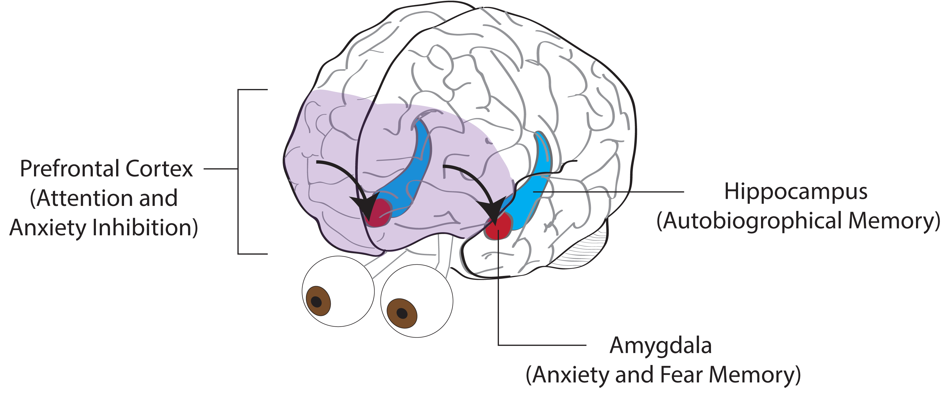
Notes:
Prefrontal Cortex – This area of the brain helps people set and achieve goals. It receives input from multiple parts of the brain to process information then responds accordingly. The prefrontal cortex contributes to a wide variety of executive functions, like focusing one's attention.
When there is underactivity in this part of the brain, intense fear such as panic disorders, post-traumatic stress disorder, and phobias can be seen which shows the inability to suppress the amygdala.
Amygdala – The center for fear response shows heighted reactivity to anxiety producing stimuli. The brain amygdala appears key in modulating fear and anxiety. People with anxiety disorders often show heightened amygdala response to anxiety cues. The amygdala and other limbic system structures are connected to prefrontal cortex regions.
The hippocampus - Is located in the medial temporal lobe and controls the creation of new memories and recalling an emotional event. Also contributes to our ability to form relationships, behaviors and judgements with others. This area of the brain is also associated with regulating fear and anxiety cues

Slide 9
Generalized Anxiety Disorder
Indications
Anxiety
Pain Relief
Sleeping better
Coping with stress
Contraindications
None
Risks: history of physical or sexual abuse
It is vital that clients feel safe and in control of their massage.
Accommodations
Be flexible to working through clothing and with another person in the room
Keep office door open
Great Communication
Notes:
Indications: Massage has been documented to help clients with anxiety disorders to help people feel calmer and more able to cope with the everyday stresses that life offers.
Also relieves pain, and helps you sleep better and cope with stress better.
Contraindications: None, but be aware of these risks: Some people have a history of physical or sexual abuse, and they may seek massage therapy to try and experience normal healthy touch. It is vital that clients feel safe, and in control of their massage.
Accommodations: It is vital that the therapist is flexible to meet the needs of a client with anxiety disorders.
Ex: Working through clothing, with another person in the room, office door open, and Communication is essential in knowing what to expect Before, During and After the massage.

Slide 10
Treatments for Generalized Anxiety
Medication
Cognitive Behavioral Therapy
Massage
Complimentary Modalities
Reiki
Notes:
Medications: Fall into three classes: antidepressants, antianxiety drugs and betablockers.
Cognitive Behavioral Therapy - CBT focuses on challenging and changing an exaggerated or irrational thought pattern involved in an anxiety or depression. (e.g. thoughts, beliefs, and attitudes)
Massage – helps decrease cortisol levels, and increase your body’s serotonin which is one of the body's anti-pain mechanisms. It has been proven that serotonin is increased by an average of 28 percent after receiving a massage.
By lowering cortisol and increasing serotonin, you're boosting your body's ability to fight off pain, anxiety and feelings of sadness.
Reiki – My favorite topic to talk about!

Slide 11
What is Reiki?
a Japanese healing technique that taps into our innate ability to offer healing and comfort through the palms of your hands.
Once attuned to Reiki, you can channel this healing energy through your hands to your client. Much like using a hose to channel water through it.
You are not using your own energy, you are simply attuned to it and allowing it to flow through you to your client. It is like charging a battery.
Reiki can never hurt you, and anyone can learn how to do it. It is not associated with any belief systems and the subtle energy can reduce pain and anxiety.

Slide 12
How Reiki and Massage Reduce Anxiety
Reiki
Assists in self-healing
Reduces pain
Relieves Nausea
Improves Fatigue
Reduces Anxiety
Helps with Sleep
Reduces Cortisol
Increases Dopamine
Massage
Calms the body’s senses
Alleviates Anxiety Symptoms
Reduces Anxiety
Reduces Cortisol
Increases Dopamine

Slide 13
Thanks for Listening
Any questions?

